Slide 1
Algorithms: Greedy Method Fractional Knapsack Problem
Course Code: CSE-2218
Data Structure and Algorithms II Lab
Lec Saifur Rahman
Email: saifur@cse.uiu.ac.bd
Mobile: +8801303529289

Slide 2

Greedy Algorithms: Principles
A greedy algorithm always makes the choice that looks best at the moment.
A greedy algorithm works in phases. At each phase:
You take the best you can get right now, without regard for future consequences.
Your hope that by choosing a local optimum at each step, you will end up at a global optimum.
For some problems, it works

Slide 3
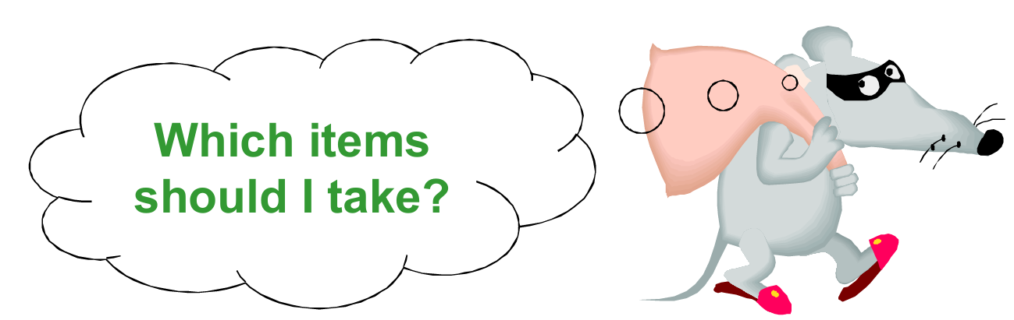
The Knapsack Problem
The famous Knapsack Problem:
A thief breaks into a museum. Fabulous paintings, sculptures, and jewels are everywhere. The thief has a good eye for the value of these objects and knows that each will fetch hundreds or thousands of dollars on the clandestine art collector’s market. But the thief has only brought a single knapsack to the robbery scene and can take away only what he can carry. What items should the thief take to maximize the haul?

Slide 4

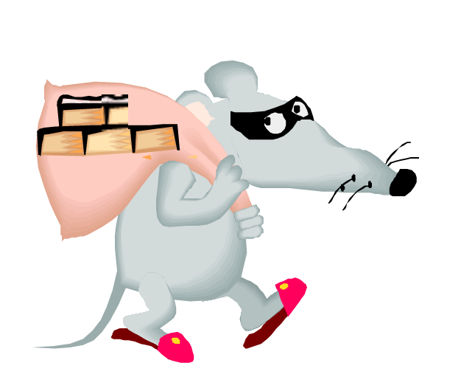
The Knapsack Problem
There are two versions of this problem:
“0-1 knapsack problem” Items are indivisible: you either take an item or not. Solved with dynamic programming.
“Fractional knapsack problem” Items are divisible: you can take any fraction of an item. Solved with a greedy algorithm.

Slide 5
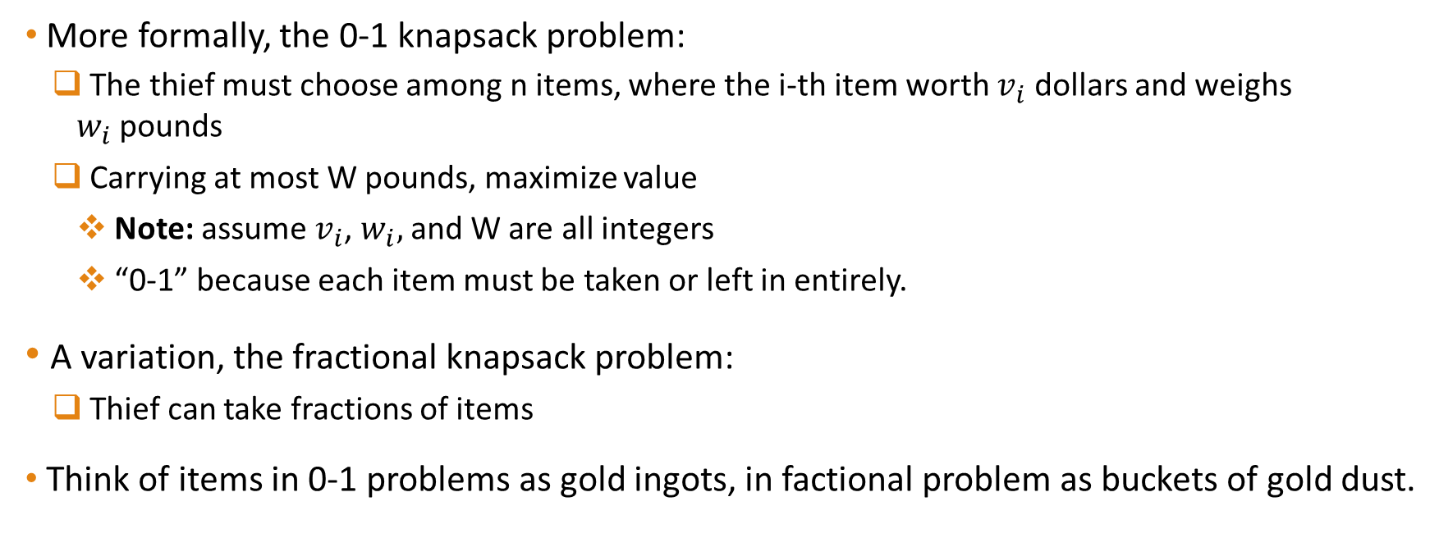
The Knapsack Problem
More formally, the 0-1 knapsack problem:
The thief must choose among n items, where the i-th item worth $v_{i}$ dollars and weighs $w_{i}$pounds
Carrying at most W pounds, maximize value
Note: assume $v_{i}$, $w_{i},$and W are all integers
“0-1” because each item must be taken or left in entirely.
A variation, the fractional knapsack problem:
Thief can take fractions of items
Think of items in 0-1 problems as gold ingots, in factional problem as buckets of gold dust.

Slide 6

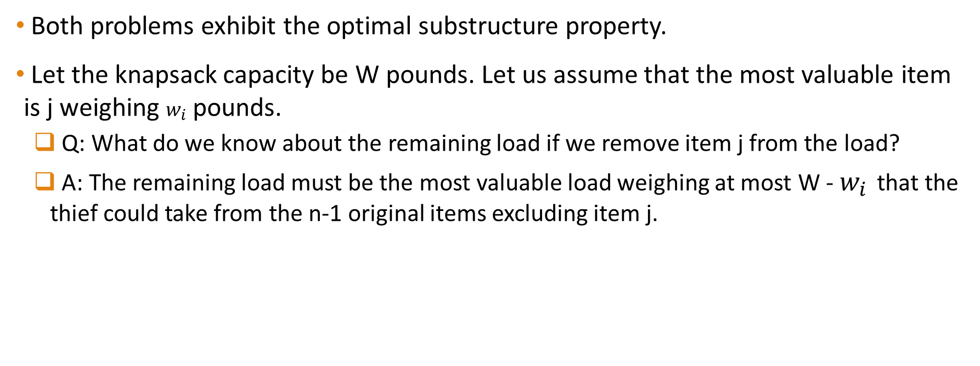
Optimal Substructure Property
Both problems exhibit the optimal substructure property.
Let the knapsack capacity be W pounds. Let us assume that the most valuable item is j weighing $w_{i}$ pounds.
Q: What do we know about the remaining load if we remove item j from the load?
A: The remaining load must be the most valuable load weighing at most W - $w_{i}$ that the thief could take from the n-1 original items excluding item j.

Slide 7

Fractional Knapsack Problem
Knapsack capacity: W
There are n items: the i-th item has value $v_{i}$ and wight $w_{i}$
Goal:
find $x_{i}$such that for all $0 ≤ x_{i} ≤1, i=1, 2, …, n$ $\sum{w_{i}x_{i} ≤W}$ and $\sum{x_{i}v_{i}}$ is maximum

Slide 8
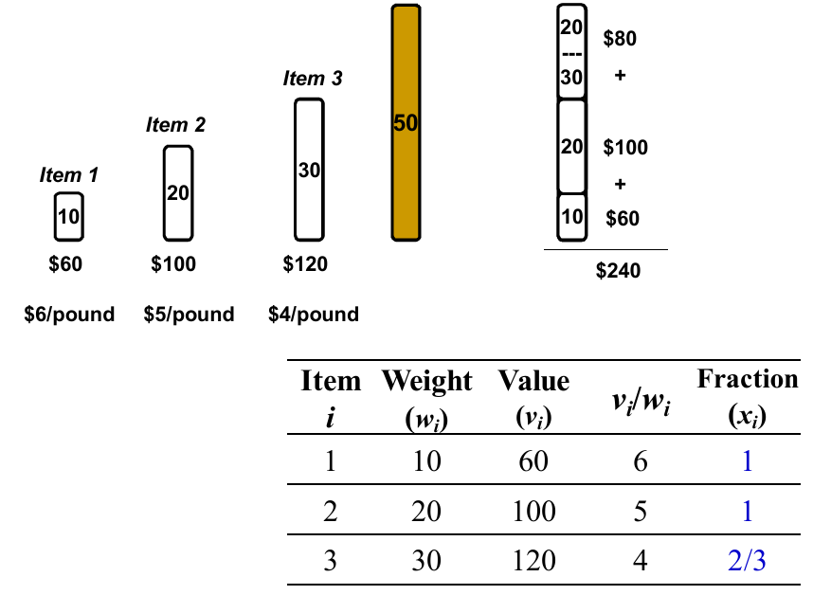
Fractional Knapsack - Example

Slide 9
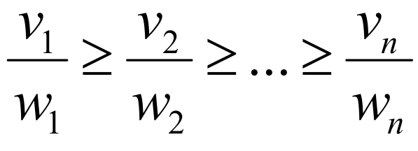
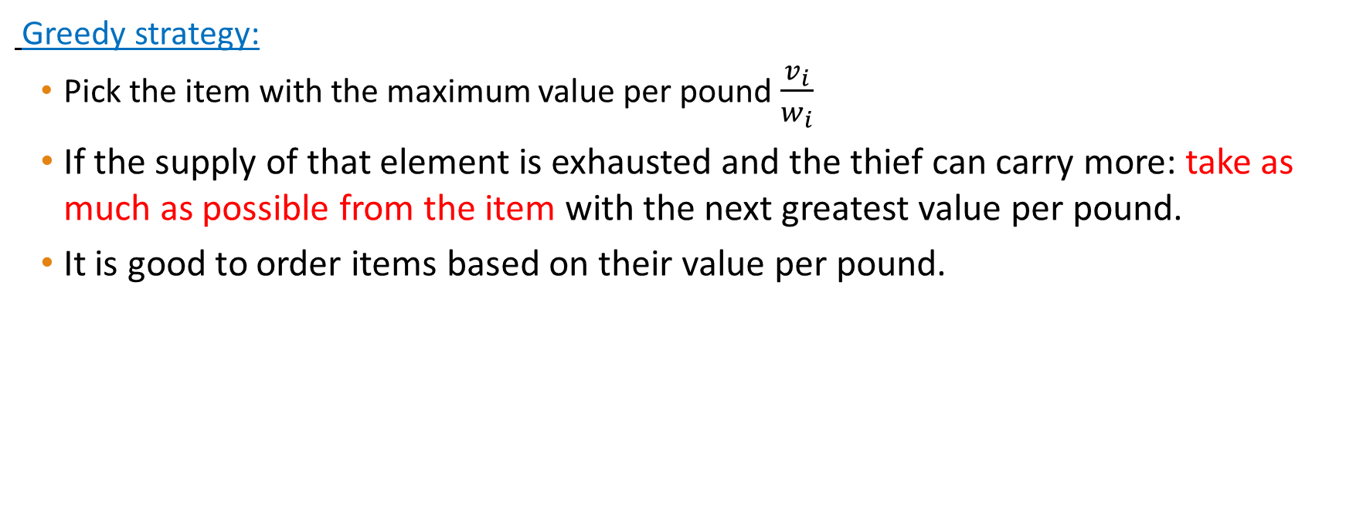
Fractional Knapsack Problem
Greedy strategy:
Pick the item with the maximum value per pound $\frac{v_{i}}{w_{i}}$
If the supply of that element is exhausted and the thief can carry more: take as much as possible from the item with the next greatest value per pound.
It is good to order items based on their value per pound.

Slide 10
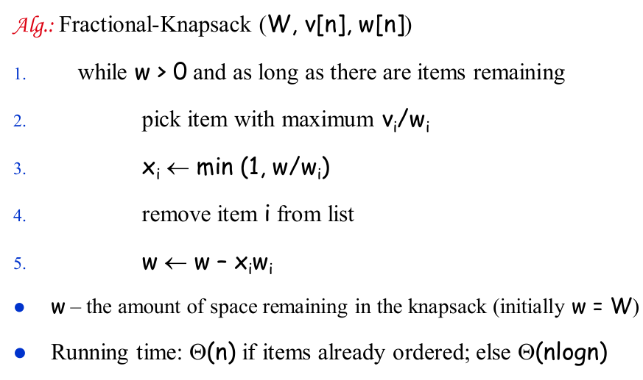
Fractional Knapsack Problem

Slide 11
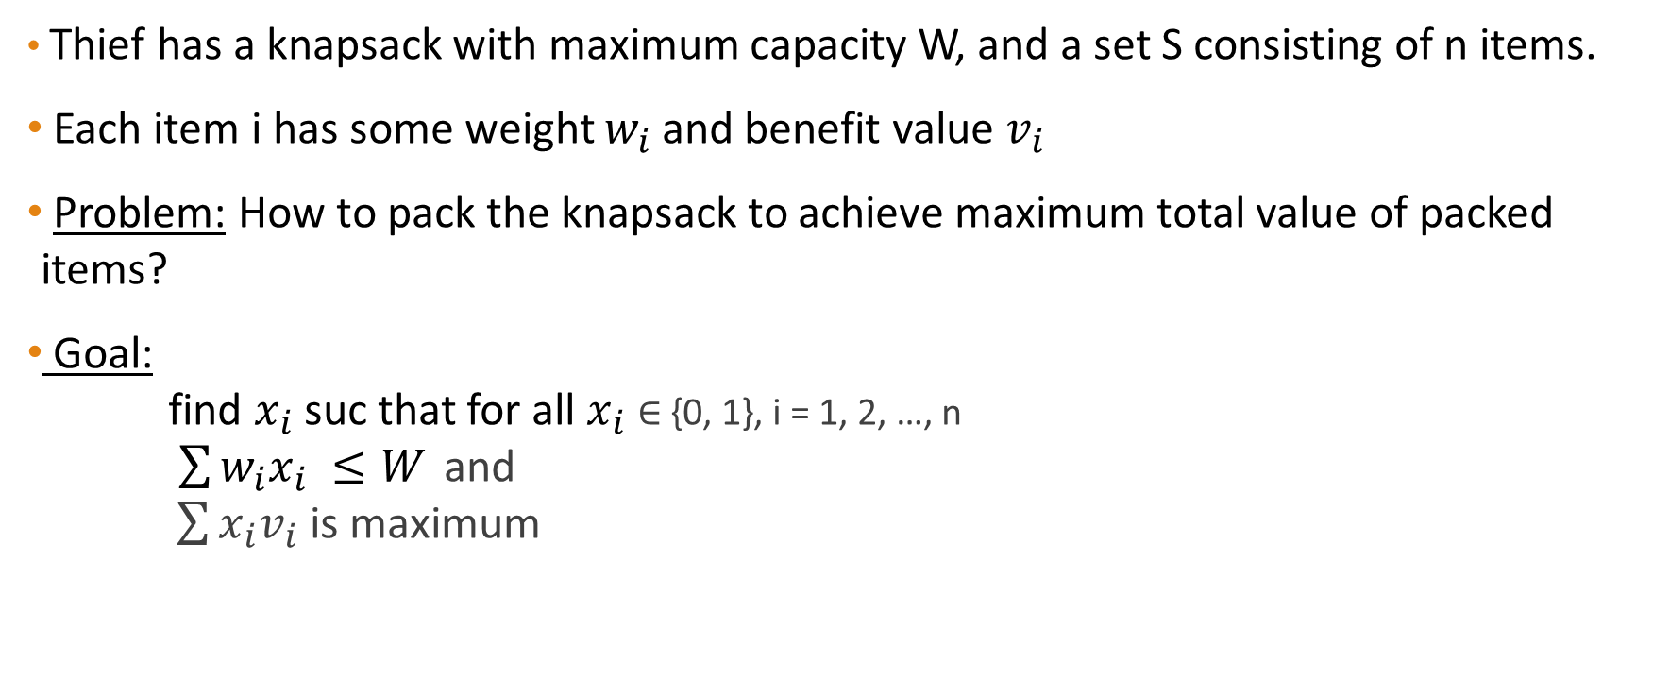
0-1 knapsack Problem
Thief has a knapsack with maximum capacity W, and a set S consisting of n items.
Each item i has some weight $w_{i}$ and benefit value $v_{i}$
Problem: How to pack the knapsack to achieve maximum total value of packed items?
Goal: find $x_{i}$suc that for all $x_{i}$ ∈ {0, 1}, i = 1, 2, …, n $\sum{w_{i}x_{i} ≤W}$ and $\sum{x_{i}v_{i}}$ is maximum

Slide 12
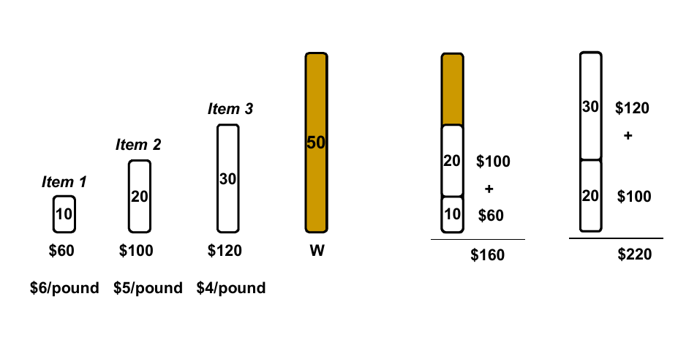
0-1 knapsack – Greedy Strategy Fails

